Slide 1

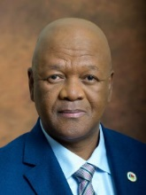
Key Note Address by Hon. Mr Jeff Radebe,
MP and Minister in the Presidency for Planning, Monitoring and Evaluation and Chairperson of the National Planning Commission
Occasion: Vision 2030 Summit
THEME: Why the NDP forms the basis for all government activities?
Date: 9 June 2016, Emperor's Palace, Gauteng

Slide 2
Aim
The presentation will serve two purposes:
  To explain the rationale behind the fact that NDP is the country’s blueprint long-term plan, not just for government only
  To share progress made in implementing the NDP as a collaborative effort between Government and its social partners such a business, labour and civil society – with a special focus on the economic matters

Slide 3
The Birth of a New Democratic State
In 1994 we attained our new South Africa as an outcome of a prolonged struggle for freedom and liberation.
The first Head of the new democratic State, former President Nelson Mandela famously declared during his inauguration in 1994:
  “Never, never and never again shall it be that this beautiful land will again experience the oppression of one by another and suffer the indignity of being the skunk of the world. Let freedom reign. The sun shall never set on so glorious a human achievement! God bless Africa!”
So, the new democratic government came into being

Slide 4
National Building, Reconstruction and Development
Since the 1994 electoral breakthrough, our first task was to establish a foundation for a long-term journey of nation building, reconstruction and development
The 1996 Constitution of the Republic is our all encompassing vision, as part of its Preamble declares that:
  “We therefore, through our freely elected representatives, adopt this Constitution as the supreme law of the Republic so as to:
    Heal the divisions of the past and establish a society based on democratic values, social justice and fundamental human rights;
    Lay the foundations for a democratic and open society in which government is based on the will of the people and every citizen is equally protected by law;
    Improve the quality of life of all citizens and free the potential of each person; and
    Build a united and democratic South Africa able to take its rightful place as a sovereign state in the family of nations.
    May God protect our people. Nkosi Sikelel' iAfrika. Morena boloka setjhaba sa heso.”

Slide 5
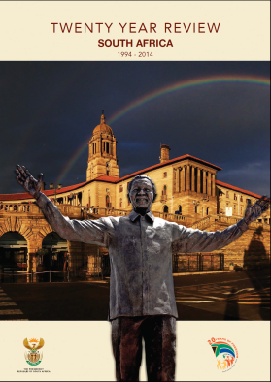
Two Decades of Freedom
In 2014, Government released a 20-Year Review report which is publicly available from the website of the Department of Planning, Monitoring and Evaluation (DPME)
The report reflects on the legacy that the democratic South Africa inherited, how the country has progressed in realising the objectives it set for itself in 1994, the challenges which still remain and how we could best address these as we entered the third decade of democracy.
It analyses scientific evidence which demonstrates that indeed our country has a good story to tell in relation to:
  Governance and administration
  Social transformation
  Economic transformation
  Infrastructure development
  Sustainable development
  Safety and security, and
  International relations

Slide 6

The First National Planning Commission is Inaugurated
At the inaugural meeting of the 1st NPC on 11 May 2010, President Zuma stated:
“The mandate of the commission is to take a broad, cross-cutting, independent and critical view of South Africa, to help define the South Africa we seek to achieve in 20 years time and to map out a path to achieve those objectives. The commission is expected to put forward solid research, sound evidence and clear recommendations for government.
The commission will also work with broader society to draw on the best expertise, consult the relevant stakeholders and help to shape a consensus on what to do about the key challenges facing us. Government has often taken a sectoral and short-term view that has hampered development. Taking a long-term and independent view will add impetus, focus and coherence to our work.
The establishment of the National Planning Commission is our promise to the people of South Africa that we are building a state that will grow the economy, reduce poverty and improve the quality of life of our citizens”

Slide 7
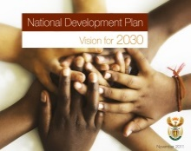

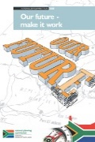
The History of the Commission
Apr President Zuma appoints the Commission
Jun Diagnostic Report published
Nov Draft National Development Plan released
Public consultation
Aug Handover to President and Nation
Sep Cabinet adopts the Plan
Dec ANC Conference adopts the Plan
Aug Launch of MTSF
Oct President Zuma appoints
the second Commission
2010
2011
2011/12
2012
2014
2015

Slide 8
Leading Development of Long-term Vision and Plan
During the diagnostic phase, each working group produced a report on its thematic issue, all synthesised to form a diagnostic report, the Diagnostic Overview – the NPC’s first output.
The purpose of the diagnostic document was to identify, as a basis for preparing the NDP, the main challenges facing the country.
The document identified nine such challenges, each an impediment to realising the objectives of eliminating poverty and reducing inequality.
Strategic Objectives: Eliminating Poverty, Reducing Inequality and Unemployment
Poor
educational
outcomes
High
disease
burden
Crumbling
infrastructure
Divided
communities
Eliminating poverty
Bad use of
natural resources
Reducing inequality
Public service
performance is
uneven
Corruption
Workers living
far from places
of work
Too few
South Africans
are employed
8
Notes:
During the diagnostic phase, each working group produced a report on its thematic issue. The five reports were then synthesised to form a diagnostic report, the Diagnostic Overview – the NPC’s first output.
The purpose of the diagnostic document was to identify, as a basis for preparing the NDP, the main challenges facing the country.
The document identified nine such challenges, each an impediment to realising the objectives of eliminating poverty and reducing inequality.
The commission made the overview of the diagnostic report available in all 11 official languages and Braille. Following the public participation phase, a further four challenges – rural development, community safety, social protection and regional development – were added

Slide 9
The Vision Statement
Extract from the NDP:
  “We, the people of South Africa, have journeyed for since the long lines of our first democratic election on 27 April 1994, when we elected a government for us all. We began to tell a new story then. We have lived and renewed that story along the way. Now in 2030 we live in a country which we have remade. We have created a home where everybody feels free yet bounded to others; where everyone embraces their full potential. We are proud to be a community that cares…”
Therefore our vision is to eliminate poverty, reduce inequality and unemployment
As our blueprint plan and vision 2030, the NDP captures the essence of what needs to be done, proposes specific policy actions, sets targets and identify mechanisms for effective implementation in key areas clustered into 15 chapters

Slide 10
The Broad Strategy of the NDP
Through the NDP we aim to
Deliver effective social wage to the poor
  Especially better quality education and training
Grow labour intensive sectors such as mining, agriculture, agro-processing and tourism
Support advanced sectors to expand, especially into Africa
  Manufacturing, business services, IT enabled services
Invest in social and economic infrastructure to support these three goals

Slide 11
The NDP has a Few Key Aims
To reduce the proportion of people living in poverty from about 39% to zero.
Improve capacity of the state.
Reduce the level of inequality – Gini is presently about 0.69.
Eliminate corruption and hold government and other stakeholders accountable for performance.
Broaden social wage: delivery of a package of services including housing, social grants, public transport, water, education and health
Create 11 million jobs by 2030.
Boost export performance and raise competitiveness of the economy.
Build social cohesion and unity.

Slide 12
The New National Planning Commission
The mandate of the new NPC is to:
  promote and advance the implementation of the NDP across different sectors of society;
  undertake detailed planning in a selected number of sectors;
  conduct regular engagements with various sectors of society on all matters pertaining to the long-term development of the country;
  facilitate stakeholder engagements aimed at forging a social compact towards more effective implementation of the NDP;
  take a cross-cutting view, undertake research into long-term trends, analyse implementation of short- to medium-term plans; and
  contribute to the development of international partnerships and networks on national planning.
The NPC has decided to focus on the economy and help us formulate more effective ways of responding to the economic challenges into the long-term.
Fighting the triple challenges of poverty, unemployment, inequality remains at the core of our implementation efforts

Slide 13
IMPLEMENTATION OF THE NDP

Slide 14
The Medium-Term Strategic Framework
In 2014, the NDP was translated into the Medium Term Strategic Framework for the period 2014 – 2019 which coincides with the term of the current administration.
Government has adopted 14 outcome priorities based on the NDP.
For each outcome, there is a coordinating minister who is held accountable for its achievement.
The President has signed performance agreements with all ministers that set out what each minister is expected to deliver. This is in addition to the established practice of entering into performance agreements with directors-general and other senior managers in the public service.
On a quarterly basis a progress report on each outcome is presented to Cabinet.
DPME plays a central role in the monitoring of the implementation of the MTSF and all other government commitments

Slide 15
Poverty is Multi-dimensional
Economic activity
Unemployment is now the major driver of poverty in the country
Unemployment rate
Living standard
Quality education and skills development are also key to tackling poverty
Education
Health

Slide 16
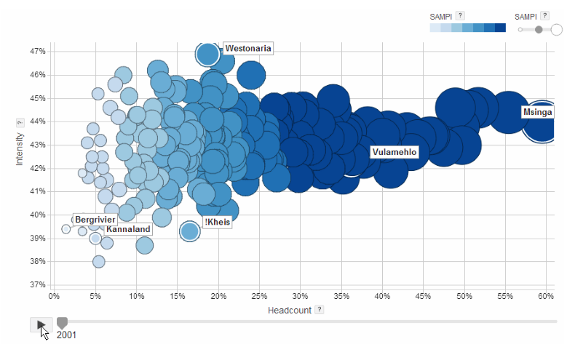
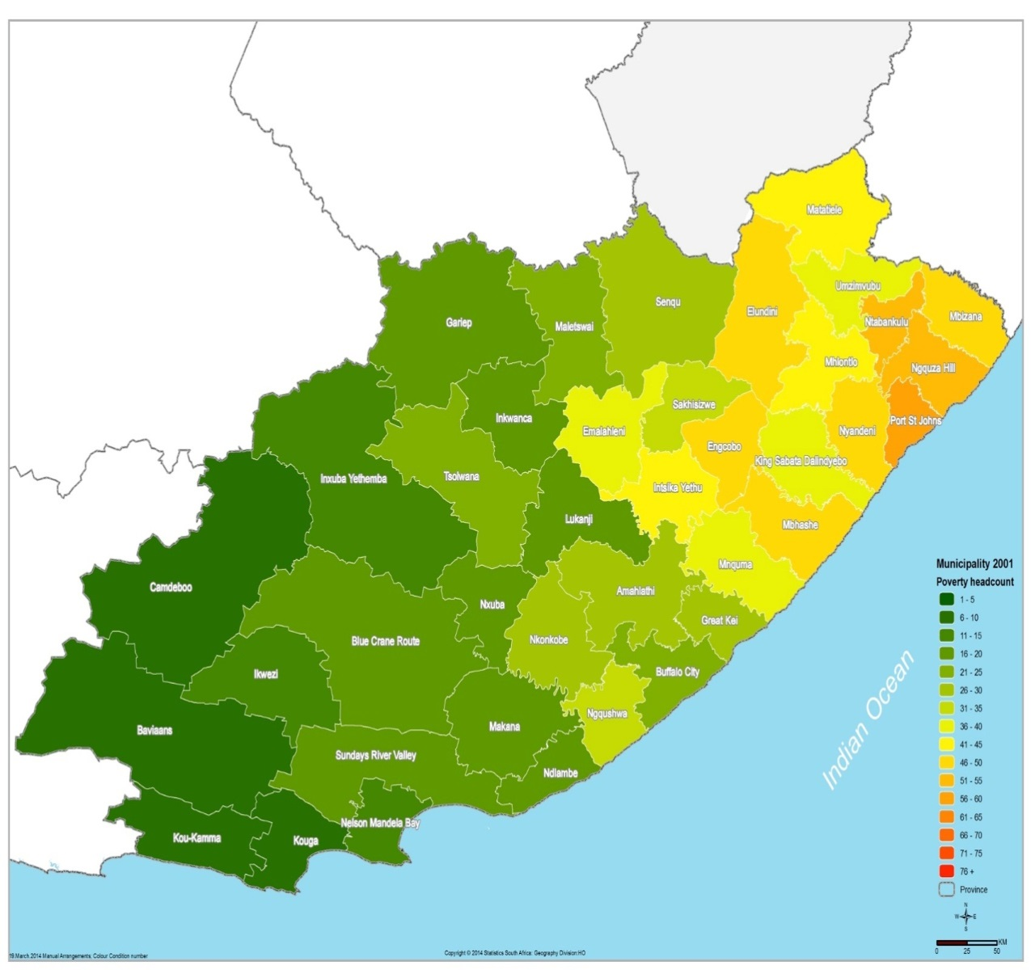
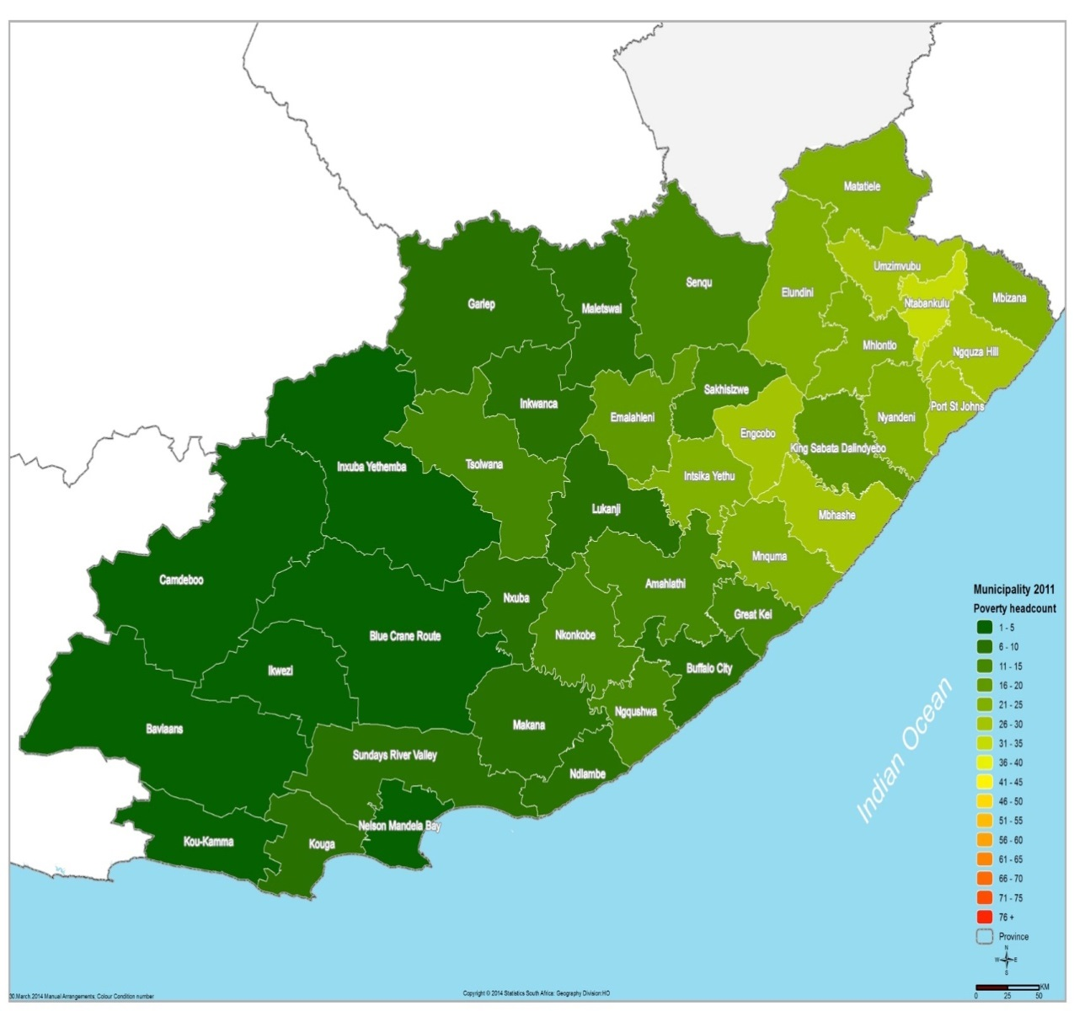
Mapping the poverty headcount by Municipality
Eastern Cape – 2001-2011 (SAMPI)
POVERTY HEADCOUNT BY MUNICIPALITY – 2001-2011 (SAMPI)
Social policies of government have dramatically
reduced head count poverty - half the number who were poor have been driven out of poverty
Intensity of poverty has also been reduced

Slide 17
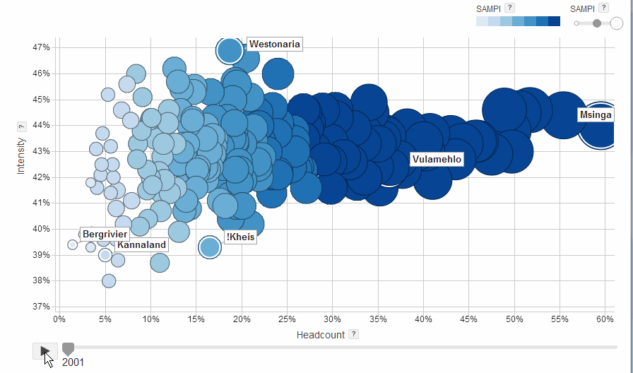
POVERTY HEADCOUNT BY MUNICIPALITY – 2001-2011 (SAMPI)

Slide 18
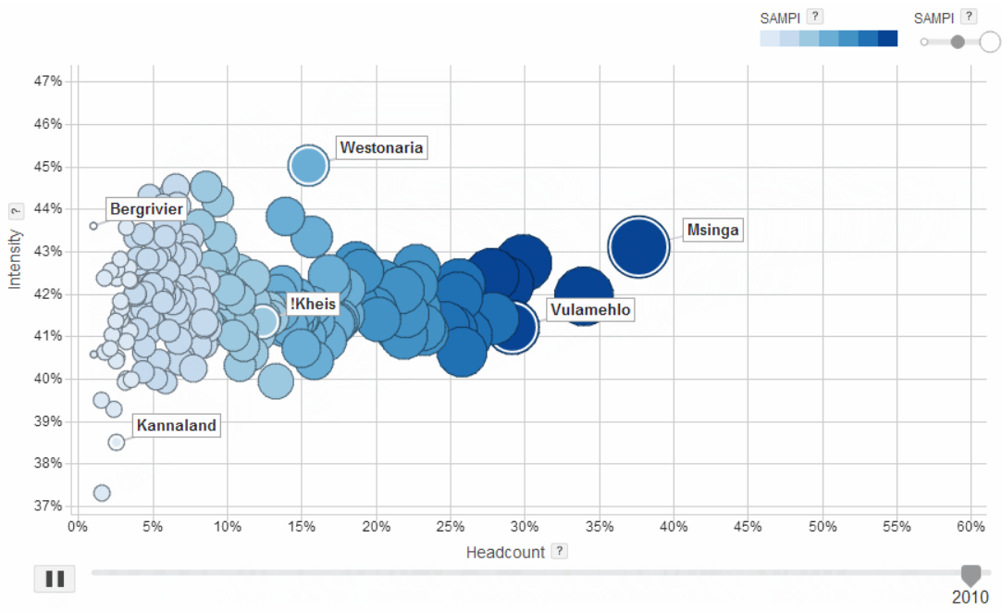
POVERTY HEADCOUNT BY MUNICIPALITY – 2001-2011 (SAMPI)
Msinga head count poverty moved from 60% to 37%
Westonaria poverty gap which measures intensity dropped from 47% to 45%

Slide 19
Percentage of People Progressing From Low to Middle Living Standards has Increased
Source: South African Audience Research Foundation, 2015
Notes:
The past decade has seen the rise of the black middle class. There was a significant shift in the country’s living standards measure between 2001 and 2013. Despite rising average income levels and the rise in the black middle class, levels of inequality have remained high, with the richest 10 percent of households capturing over half of the national income.

Slide 20
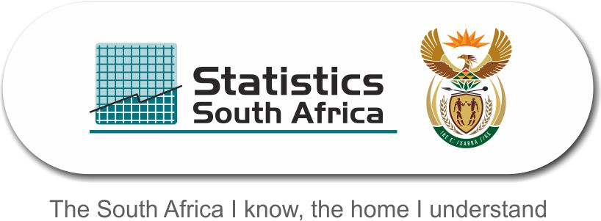
Service Delivery
Overview of various aspects of service delivery related to South African households over the period 2002 to 2015 based on the General Household Survey released by StatsSA in June 2016

Slide 21

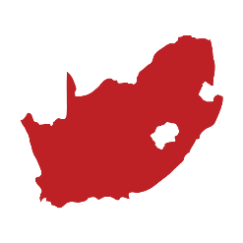
The percentage of South African households that were connected to the mains electricity supply
2015:
86%
2002:
77%

Slide 22


Percentage of households with access to piped or tap water in their dwellings, off-site or on-site
2015: 89%
2002: 85%

Slide 23
Percentage of households whose refuse is removed by the Municipality
(2002─2015)
2015:
66%
2002:
59%

Slide 24
Real GDP Growth:
Real GDP contracted by 1,2% in The first quarter of 2016, following an increase of 0,4% in the fourth quarter of 2015.
The largest negative contributor of growth in GDP was the mining and quarrying sector, which fell by 18,1% and contributed -1,5 percentage points to GDP growth
The development of the energy sector is key to easing the constraints to growth

Slide 25
Current practical initiatives to boost the economy
The 9-point plan to boost the economy is now an integral part of the MTSF:
    Resolving the energy challenge
    Upping the agricultural value chain
    Beneficiation through adding value to mineral resources
    More effective implementation of higher impact industrial policy action plan
    Encouraging private sector investment
    Moderating work place conflict
    Unlocking the potential of SMMEs, cooperatives, townships and rural enterprises
    Reform of state owned companies, broadband roll-out, water, sanitation and transport infrastructure, and
    Operation Phakisa e.g. growing the ocean economy, improving health, education and mining

Slide 26
Highlights from Operation Phakisa
Investments amounting to about R17 billion in the Ocean’s Economy;
Over 4 500 jobs have been created in the various projects of the Ocean’s Economy;
Over R7 billion has been allocated by Transnet National Ports Authority to improve our ports;
The health sector has been successful in creating 280 Ideal Clinics in 2015/16, within the group of 1 139 clinics identified for this financial year;
In order to be declared an Ideal Clinic there are standards to be met. The number of clinics scoring over 70% has increased from 139 to 445.
The number of clinics scoring less than 40% has decreased from 213 to 90 within the period of one year.

Slide 27
South African Growth in the context of Global Economic Growth
Global slowdown has exposed SA’s economic weaknesses such as low commodity prices, financial market volatility, diminished consumer and business confidence.
Government and social partners boosting confidence and putting measures to improve growth
Source: IMF
2016 forecasts

Slide 28
GLOBAL ECONOMY
Global recovery continues at a moderate pace, but elevated risks have weakened outlook
[IMF, April 2016]
Advanced economies:
Unfavourable demographic trends and low productivity growth and legacies from the financial crisis, continue to slow recovery with weak demand and low potential growth
Sub-Saharan Africa:
Has weakened due to unfavourable external conditions, including declining commodity prices, and tightening global financing. Commodity exporters are experiencing significant macro-economic challenges with lower than projected revenue and significant currency depreciation, which has eroded fiscal and foreign exchange buffers
Emerging markets and developing countries:
Continue to account for a higher proportion of global growth. Prospects are weaker and uneven across the countries. The growth has slowed, investment levels are declining, currencies are depreciating putting inflationary pressures, and financial conditions have tightened
Non-economic pressures in the African continent:
The legacy of the Ebola epidemic in West Africa; security tensions and negative geo-political developments continue to undermine inclusive growth and macro-economic stability in the region. Adverse weather conditions has also added inflationary pressures through rising food prices and increased fiscal pressures.

Slide 29
Competitiveness of the Economy
Summary of SA’s performance
South Africa climbed seven places to reach 49th, reversing its four-year downward trend on the WEF World Competitiveness Index 2016.
Positive factors include:
  Increased uptake of ICTs – especially higher internet bandwidth – and improvements in innovation (up by five places to 38th), which establish the economy as the region’s most innovative;
  South Africa also hosts the continent’s most efficient financial market (12th) and benefits from a sound goods market (38th), which is driven by strong domestic competition (28th) and an efficient transport infrastructure (29th).
  It further benefits from strong institutions (38th), particularly property rights (24th) and a robust and independent legal framework.
Negative factors include:
  Reducing corruption (76th) and the burden of government regulation (117th) and improving the security situation (102nd) would further improve institutions. The country also needs to address its inefficient electricity supply (116nd) inflexible labour market (102nd).

Slide 30
Affirmation of South Africa’s Credit Ratings by Various Global Rating Agencies is Welcomed
On 7 May: Moody’s Investors Service (Moody’s) affirmed South Africa’s government bond long-term and short-term ratings of ‘Baa2 / P-2’ respectively and assigned a negative outlook.
On 3 June 2016: S&P Global Ratings (S&P) affirmed South Africa’s long and short term foreign and local currency bond ratings at ‘BBB-/A-3’ and ‘BBB+/A-2’ respectively.
Yesterday, 8 June 2016: Fitch affirmed our long-term foreign and local currency debt at ‘BBB-’and ‘BBB’, respectively – following a downgrade in December 2015
As Government, business and labour are collectively intensifying efforts to:
  Restore confidence and boost investment amongst local and international investors;
  Unblock obstacles to faster employment growth in key sectors; and
  Undertake fiscal reforms, reform the State-Owned Enterprises (SOEs) and implement regulatory reforms.

Slide 31
Summary and Conclusion
The NDP is South Africa’s long-term plan and vision 2030, against which all our activities are conducted
It is based on the Constitution and helps the country to move forward beyond the 5-year terms of political administrations
NPC comprises prominent members from all sectors of the South African society who work together with government to implement the NDP. MTSF is used to implement the NDP in the medium-term period of 5-years (2014-2019)
The current economic conditions, which are due to both local and global unfavourable factors, demand that we focus all our efforts to boosting the country’s economy. The 9-point plan, and Operation Phakisa are some of the practical initiatives that seek to boost our economy
Government working together with business and labour to ensure that we improve the current situation
Some improvements beginning to emerge, as evidenced by the affirmation of South Africa’s credit rating by Moody’s and S&P. WEF Competiveness Index also improved.

Slide 32
“Only through effective partnerships across society can a virtuous cycle of rising confidence, rising investment, higher employment, rising productivity and incomes be generated.
South Africa requires both a capable and developmental State, able to act to redress historical inequalities and a vibrant and thriving private sector able to invest, employ people and penetrate global markets”
Source: NDP Chapter on Economy and Employment

Slide 33

Working together we can move South Africa forward and Happy Youth Month ☺
I THANK YOU!

